Slide 1
User Input Controls, Menus and Dialogs
Day 4 and 5
1

Slide 2
Contents
Input Controls
Options Menu
Contextual Menu
Dialogs

Slide 3
Input Controls

Slide 4
Accepting user input
Freeform text and numbers: EditText (using keyboard)
Providing choices: CheckBox, RadioButton, Spinner
Switching on/off: Toggle, Switch
Choosing value in range of values: SeekBar

Slide 5
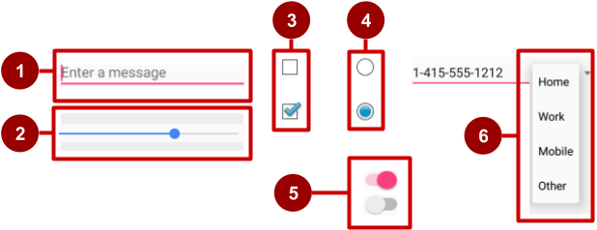
Examples of input controls
EditText
SeekBar
CheckBox
RadioButton
Switch
Spinner

Slide 6
Freeform text and numbers

Slide 7
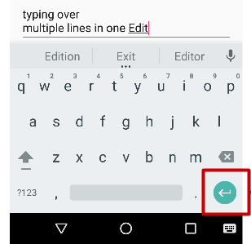
EditText for multiple lines of text
EditText default
Alphanumeric keyboard
Suggestions appear
Tapping Return (Enter) key starts new line
Return key

Slide 8
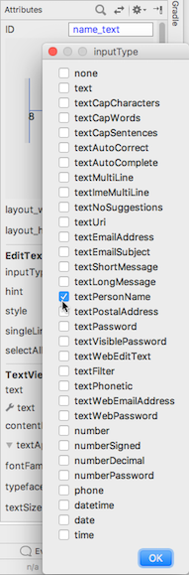
Customize with inputType
Set in Attributes pane of layout editor
XML code for EditText:
<EditText
android:id="@+id/name_field"
android:inputType =
"textPersonName"
...

Slide 9
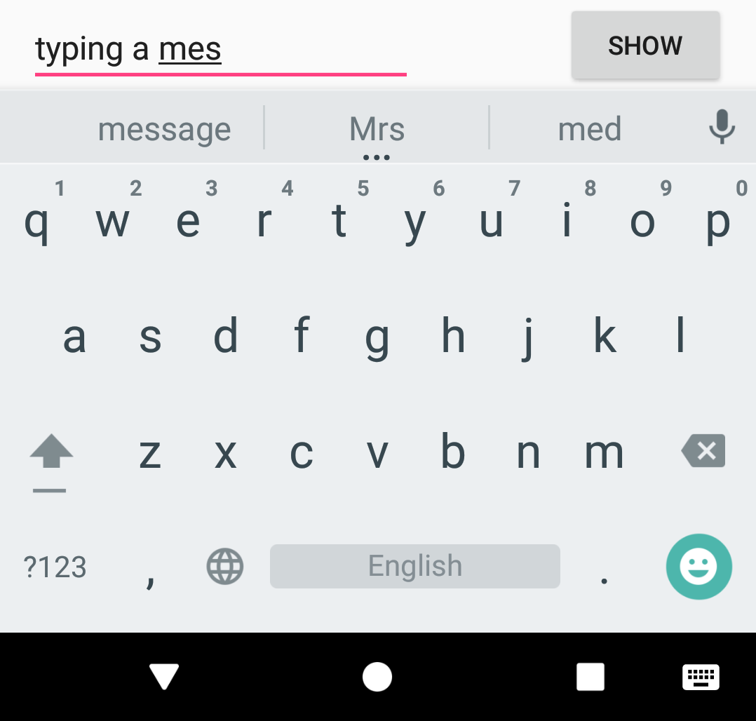
EditText for message
android:inputType ="textShortMessage"
Single line of text
Tapping Emoticons key changes keyboard to emoticons
Emoticons

Slide 10
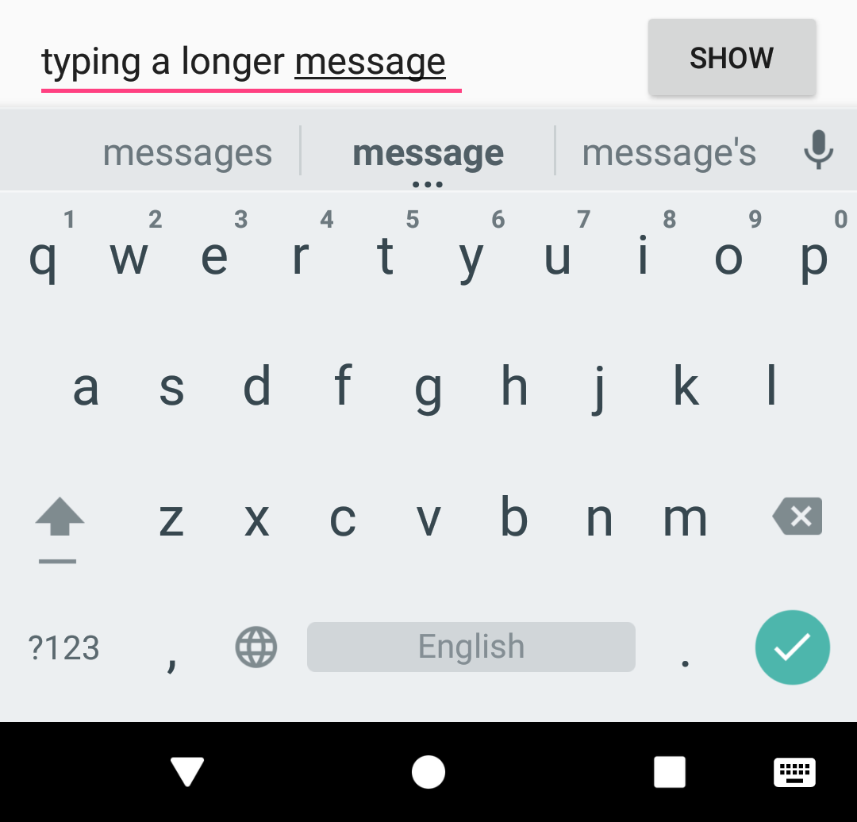
EditText for single line
Both work:
android:inputType ="textLongMessage"
android:inputType ="textPersonName"
Single line of text
Tapping Done key advances focus to next View
Done key

Slide 11
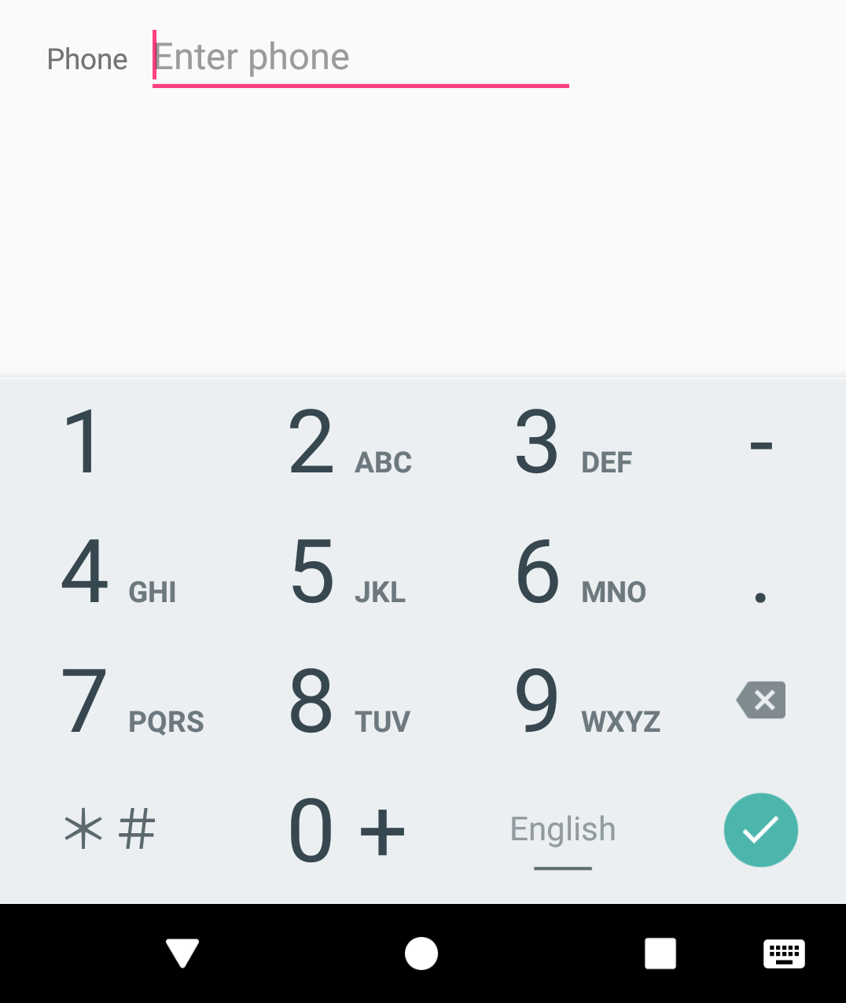
EditText for phone number entry
android:inputType ="phone"
Numeric keypad (numbers only)
Tapping Done key advances focus to next View
Done key

Slide 12
Getting text
Get the EditText object for the EditText view
EditText simpleEditText = findViewById(R.id.edit_simple);
Retrieve the CharSequence and convert it to a string
String strValue = simpleEditText.getText().toString();

Slide 13
Common input types
textCapCharacters: Set to all capital letters
textCapSentences: Start each sentence with a capital letter
textPassword: Conceal an entered password
number: Restrict text entry to numbers
textEmailAddress: Show keyboard with @ conveniently located
phone: Show a numeric phone keypad
datetime: Show a numeric keypad with a slash and colon for entering the date and time

Slide 14
Providing choices

Slide 15
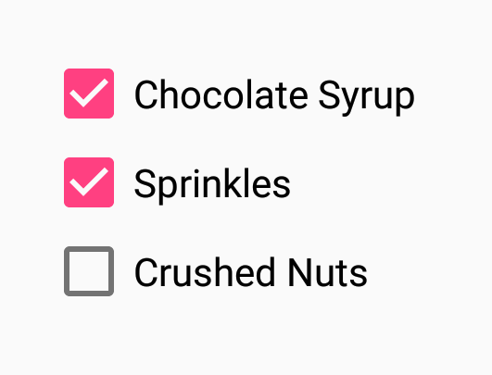
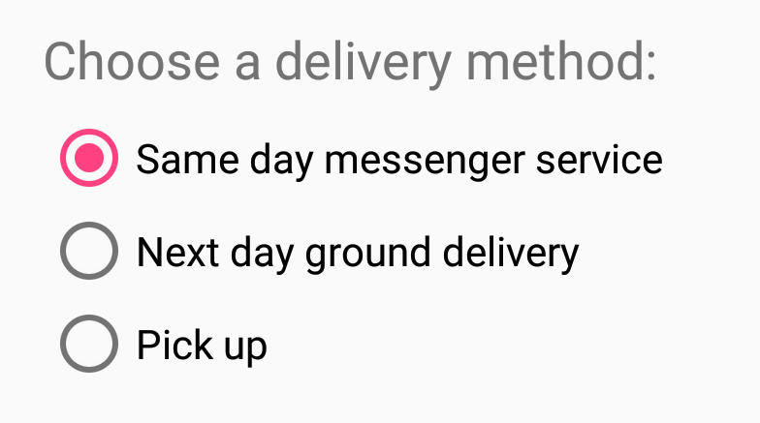

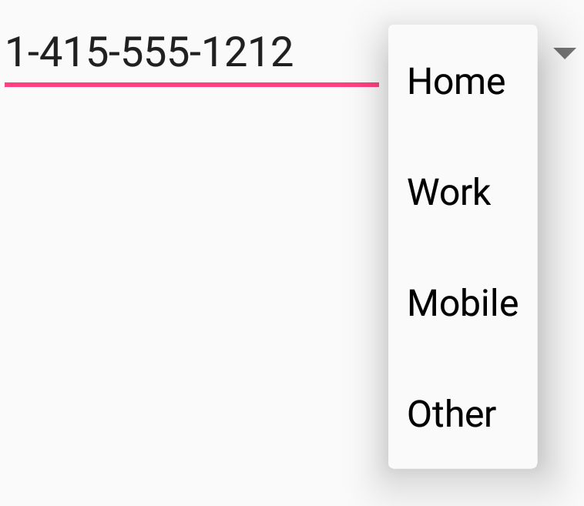

UI elements for providing choices
CheckBox and RadioButton
ToggleButton and Switch
Spinner

Slide 16
CheckBox
User can select any number of choices
Checking one box does not uncheck another
Users expect checkboxes in a vertical list
Commonly used with a Submit button
Every CheckBox is a View and can have an onClick handler

Slide 17
RadioButton
Put RadioButton elements in a RadioGroup in a vertical list (horizontally if labels are short)
User can select only one of the choices
Checking one unchecks all others in group
Each RadioButton can have onClick handler
Commonly used with a Submit button for the RadioGroup

Slide 18
Toggle buttons and switches
User can switch between on and off
Use android:onClick for click handler
Toggle buttons
Switches

Slide 19
Options Menu

Slide 20
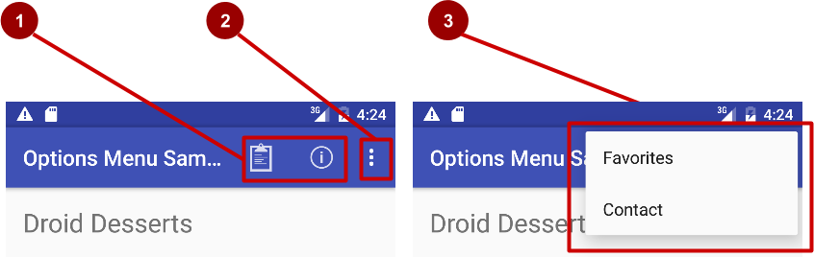

What is the options menu?
Action icons in the app bar for important items (1)
Tap the three dots, the "action overflow button" to see the options menu (2)
Appears in the right corner of the app bar (3)
For navigating to other activities and editing app settings

Slide 21
Adding Options Menu

Slide 22
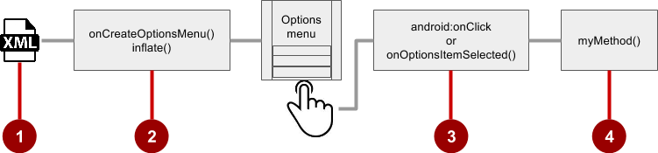
Steps to implement options menu
XML menu resource (menu_main.xml)
onCreateOptionsMenu() to inflate the menu
onClick attribute or onOptionsItemSelected()
Method to handle item click

Slide 23
Create menu resource
Create menu resource directory
Create XML menu resource (menu_main.xml)
Add entry for each menu item (Settings and Favorites):
<item android:id="@+id/option_settings"
android:title="Settings" />
<item android:id="@+id/option_favorites"
android:title="Favorites" />

Slide 24
Inflate options menu
Override onCreateOptionsMenu() in Activity
@Override
public boolean onCreateOptionsMenu(Menu menu) {
getMenuInflater().inflate(R.menu.menu_main, menu);
return true;
}

Slide 25
Override onOptionsItemSelected()
@Override
public boolean onOptionsItemSelected(MenuItem item) {
switch (item.getItemId()) {
case R.id.action_settings:
showSettings();
return true;
case R.id.action_favorites:
showFavorites();
return true;
default:
return super.onOptionsItemSelected(item);
}
}

Slide 26
Contextual Menus

Slide 27
What are contextual menus?
Allows users to perform action on selected View
Can be deployed on any View
Most often used for items in RecyclerView, GridView, or other View collection

Slide 28
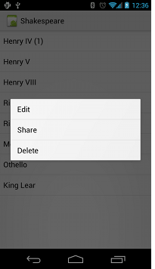
contextual menus
Context menu—long-press on a View
User can modify View or use it in some fashion
User performs action on one View at a time

Slide 29
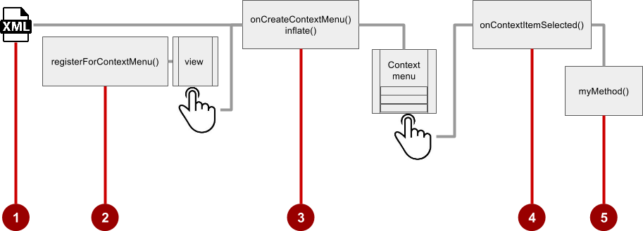
Steps
Create XML menu resource file and assign appearance and position attributes
Register View using registerForContextMenu()
Implement onCreateContextMenu() in Activity to inflate menu
Implement onContextItemSelected() to handle menu item clicks
Create method to perform action for each context menu item

Slide 30
Create menu resource
Create XML menu resource (menu_context.xml)
<item
android:id="@+id/context_edit"
android:title="Edit"
android:orderInCategory="10"/>
<item
android:id="@+id/context_share"
android:title="Share"
android:orderInCategory="20"/>

Slide 31
Register a view to a context menu
In onCreate() of the Activity:
Register View.OnCreateContextMenuListener to View:
TextView article_text = findViewById(R.id.article);
registerForContextMenu(article_text);

Slide 32
Implement onCreateContextMenu() onCreateContextMenu() method
Specify which context menu
@Override
public void onCreateContextMenu(ContextMenu menu, View v,
ContextMenu.ContextMenuInfo menuInfo) {
super.onCreateContextMenu(menu, v, menuInfo);
MenuInflater inflater = getMenuInflater();
inflater.inflate(R.menu.menu_context, menu);
}

Slide 33
Implement onContextItemSelected() onCreateContextMenu() method
@Override
public boolean onContextItemSelected(MenuItem item) {
switch (item.getItemId()) {
case R.id.context_edit:
editNote();
return true;
case R.id.context_share:
shareNote();
return true;
default:
return super.onContextItemSelected(item);
}
}
The view

Slide 34
Dialogs

Slide 35
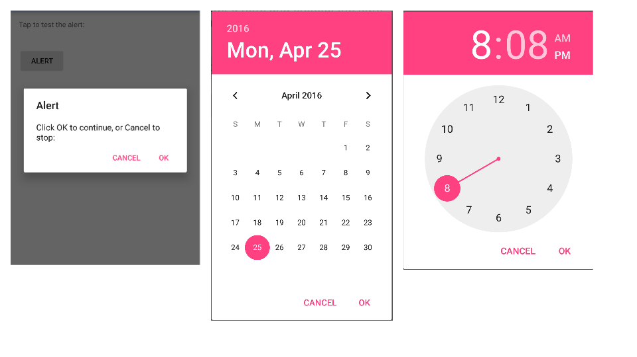
Dialogs and pickers
Alert dialog
Date picker
Time picker
1
2
3

Slide 36
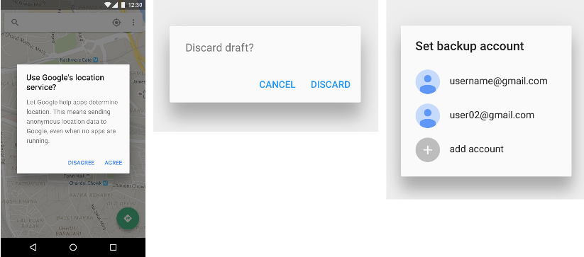
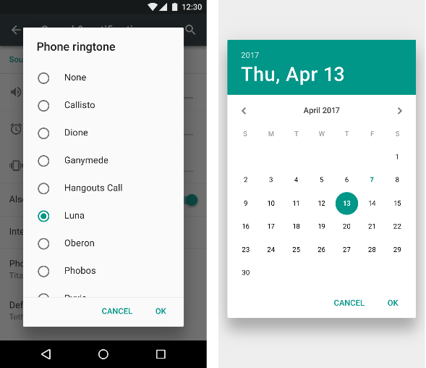
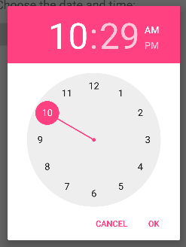
Dialogs
Dialog appears on top, interrupting flow of Activity
Requires user action to dismiss
TimePickerDialog
DatePickerDialog
AlertDialog

Slide 37
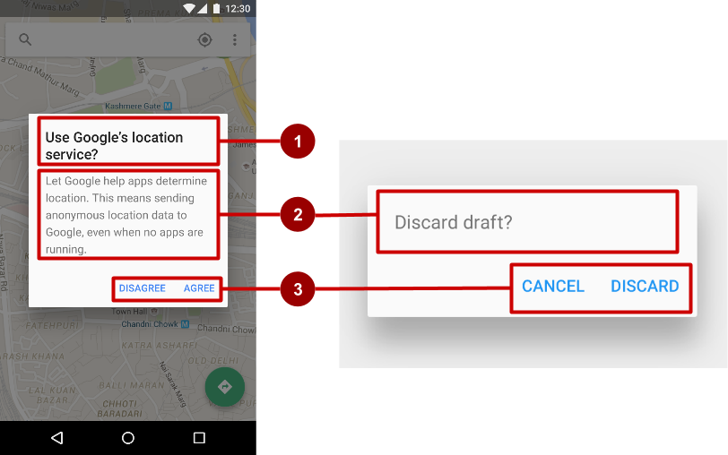
AlertDialog
AlertDialog can show:
Title (optional)
Content area
Action buttons

Slide 38
Build the AlertDialog
Use AlertDialog.Builder to build alert dialog and set attributes:
public void onClickShowAlert(View view) {
AlertDialog.Builder alertDialog = new
AlertDialog.Builder(MainActivity.this);
alertDialog.setTitle("Connect to Provider");
alertDialog.setMessage(R.string.alert_message);
// ... Code to set buttons goes here.

Slide 39
Set the button actions
alertDialog.setPositiveButton()
alertDialog.setNeutralButton()
alertDialog.setNegativeButton()

Slide 40
alertDialog code example
alertDialog.setPositiveButton(
"OK", newDialogInterface.OnClickListener() {
public void onClick(DialogInterface dialog, int which) {
// User clicked OK button.
}
});
Same pattern for setNegativeButton() and setNeutralButton()

Slide 41
END

